Slide 1

A la Luz del Maestro
#80-94

Slide 2

“Felices los misericordiosos, porque ellos alcanzaran misericordia”
La misericordia tiene dos aspectos: es dar, ayudar servir a los otros, y También perdonar y comprender.
El Evangelista San Mateo lo resume en una regla de oro “Todo lo que queráis que haga la gente con vosotros, hacedlo vosotros con ella” Mateo 7, 12.

Slide 3
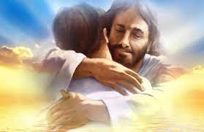
Dar y perdonar es intentar reproducir en nuestras vidas un pequeño reflejo de la perfección de Dios, que da y perdona sobreabundantemente.

Slide 4
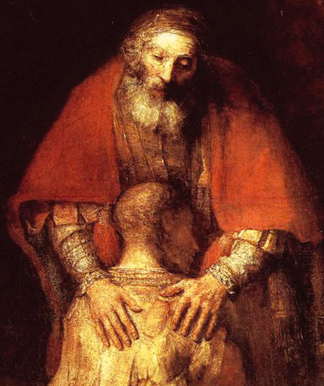
“Felices los misericordiosos porque ellos alcanzaran misericordia”
En el Evangelio de San Lucas, Jesus nos dice, “Sed misericordiosos como vuestro Padre es misericordioso; no juzgueis, y no seres juzgados; no condeneis, y no series condenados; perdonad, y sereis perdonados; dad y se os dara” (Lucas 6; 36-38)

Slide 5
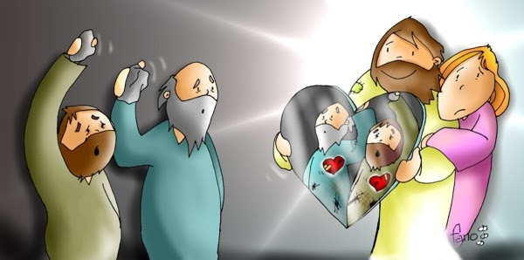
El Evangelista San Lucas agrega, “Con la medida con que midiereis se os medirá a vosotros” (6,38).

Slide 6
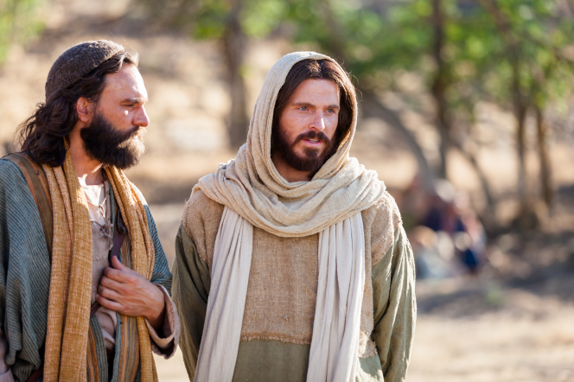
Jesús llama felices a aquellos que perdonan y lo hacen “setenta veces siete” (Mt. 18,22)

Slide 7
“Felices los de corazón puro, porque ellos verán a Dios”
Esta bienaventuranza se refiere a quienes tienen un corazón sencillo, puro, sin suciedad, porque un corazón que sabe amar no deja entrar en su vida algo que atente contra ese amor, algo que lo debilite o lo ponga en riesgo.

Slide 8

“El hombre mira las apariencias, pero el Señor mira el corazón” (1 S16,7)
El busca hablarnos en el corazón (Os 2, 16).
Y allí desea escribir su Ley (Jer 31, 33)
En definitive quiere darnos un corazón nuevo (Ez 36,26)

Slide 9

“Lo que mas hay que cuidar es el corazón”
El Padre que ve en lo secreto, reconoce lo que no es limpio, es decir lo que no es sincero, sino solo cascara y apariencia, así como el Hijo sabe también “lo que hay dentro de cada hombre” (Jn 2, 25)

Slide 10
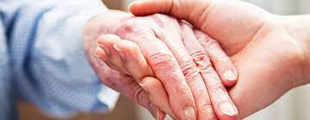
Esta bienaventuranza nos recuerda que el Señor espera una entrega al hermano que brote del corazón, ya que “Si repartiera todos mis bienes entre los necesitados; si entregara mi cuerpo a las llamas, pero no tengo amor, de nada me serviría (1 Co 13,3)

Slide 11
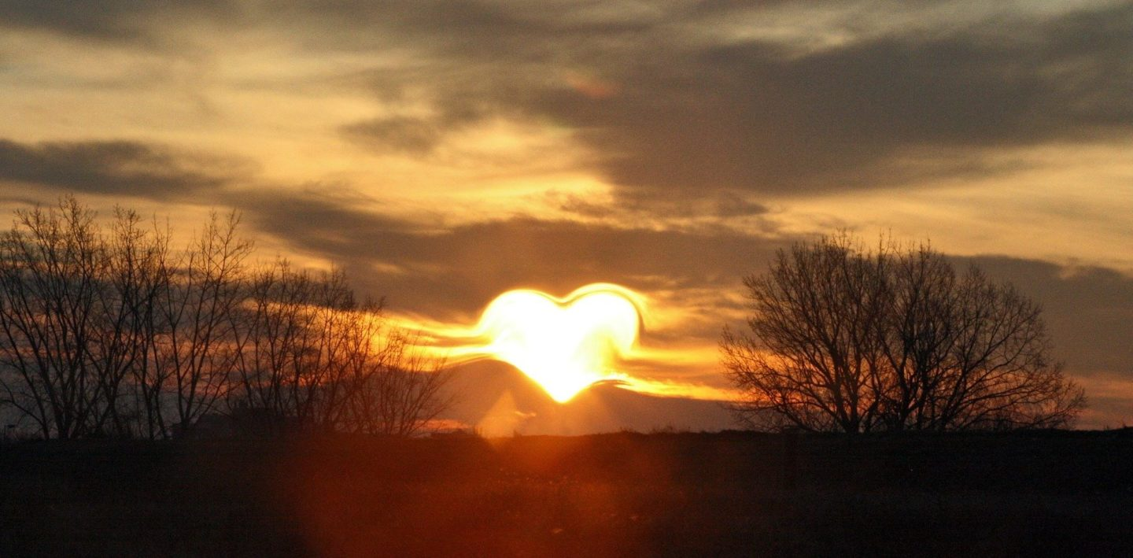
San Pablo, en medio de su himno a la caridad, recuerda que “Ahora vemos como en un espejo, confusamente”
( 1 Co 13,12),pero en la medida que reine de verdad el amor, nos volveremos capaces de ver “cara a cara”.
Jesús promete que los de corazón puro ”verán a Dios”.

Slide 12

“Felices los que trabajan por la paz, porque ellos serán llamados hijos de Dios”
Esta bienaventuranza nos hace pensar en las numerosas situaciones de guerra que se repiten. Para nosotros es muy común ser agentes de enfrentamientos o al menos de malentendidos.
El mundo de las habladurías, hecho por gente que se dedica a criticar y destruir, no construye la paz. Esa gente mas bien es enemiga de la paz y de ningún modo bienaventurada.

Slide 13
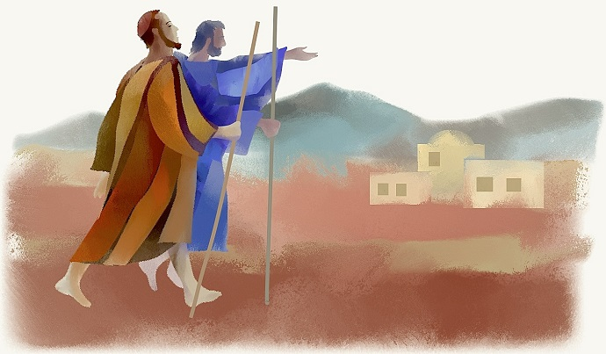
Jesús pedía a los discípulos que cuando llegaran a un hogar dijeran: “Paz a esta casa” (Lc. 10,5)
La Plabara de Dios exhorta a cada creyente para que busque la paz junto con todos (2 Tim 2,22).
Por que “El fruto de la justicia se siembra en la paz para quienes trabajan por la paz” (St 3,18)

Slide 14

No es fácil construir esta paz. Requiere de una gran amplitud de mente y corazón.
No pretende ignorar o disimular los conflictos, sino “aceptar sufrir el conflicto, resolverlo y transformarlo en el eslabón de un nuevo proceso.
Se trata de ser artesanos de la paz, porque construir la paz es un arte que requiere serenidad, creatividad, sensibilidad y destreza.

Slide 15
“Felices los perseguidos por causa de la justicia, porque de ellos es el reino de los cielos”

Slide 16
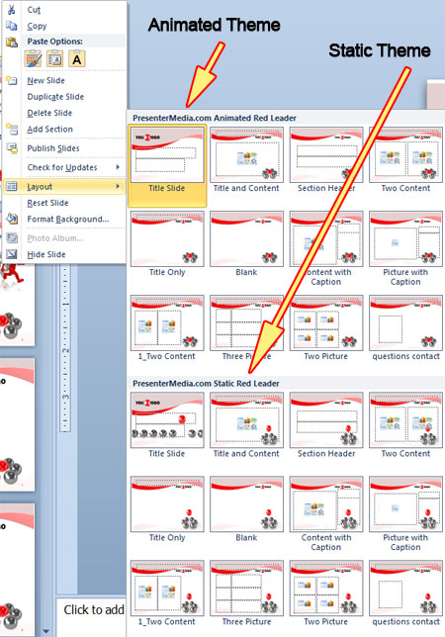
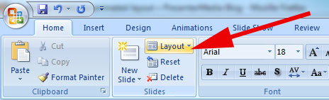
Animated or Static?
You can change between static and animated layouts by clicking on the Layout tab in the HOME menu on the ribbon.
For example this slide uses the static layout.

Slide 17
PowerPoint 2010 & 2007* and PowerPoint 2008 & 2011 (Mac)**
Troubleshooting Guide
Use this template in either PowerPoint 2007 or 2010 for the PC or PowerPoint 2008 or 20011 for Mac.
Presentations saved from this template in .PPTX format will work in PowerPoint 2007, 2008(Mac), 2010, 2011(Mac).
Presentations saved in the older .PPT format (compatibility mode) will work in all versions of PowerPoint ‘97 through 2011. But .PPT files will no longer contain the video animation.
*PowerPoint 2007
If the video is not playing with PowerPoint 2007 you are missing a required update from Microsoft.
The Office 2007 Service Pack 2 installs automatically with Windows Update.
You can also download the update manually from Microsoft here.
**PowerPoint 2008 and 2011.
If the video animation is not playing on a Mac computer you are missing a required plug-in for QuickTime.
Flip4Mac is a WMV video plug-in for Quicktime. It is a free plug-in distributed by Microsoft.
Get the Plug-in here.

Slide 18

Alternate Content Page
An alternate content page with a printable background color.

Slide 19

Main Content Page Layout
This text is a placeholder.
Here is the second level.
You may change this text
Here is the third level
Formatting is controlled
by the slide master
and the layout pages.
There is a third level
And even a fourth level

Slide 20


Two Picture Page Layout
A placeholder for text for the first picture
    More information can be added here by changing this text.
A placeholder for the second picture
    More information can be added here by changing this text.
    Make changes to this text.

Slide 21



Three Picture Page Layout
A description of the first picture. You may change this text.
A description of the first picture. You may change this text.
A description of the second picture. You may change this text.
A description of the second picture. You may change this text.
A description of the third picture. You may change this text.
A description of the third picture. You may change this text.

Slide 22

Table Page Layout
Geographic Region | Q1 | Q2 | Q3 | Q4
United States | 1254 | 1873 | 1015 | 2284
Europe and Asia | 324 | 310 | 300 | 419
Australia | 15 | 18 | 13 | 20
Canada | 6 | 3 | 4 | 7
Mexico | 1 | .5 | .5 | 2
TOTALS | 1600 | 2205 | 1333 | 2732
Here is the description of the table. You may change or delete this text as you wish.
This chart is compatible with PowerPoint 97 to 2007.
Here is a placeholder for more text and description of the chart. Changing this text will not interfere with the formatting of this template.

Slide 23

Comparison Table Layout
Quarter | North America | Asia | Europe | Australia
Q1 2009 | 123 | 34 | 45 | 10
Q2 2009 | 134 | 35 | 44 | 12
Q3 2009 | 150 | 45 | 50 | 14
Q4 2009 | 201 | 55 | 60 | 18
Q1 2010 | 175 | 44 | 47 | 13
Q2 2010 | 180 | 48 | 52 | 14
Q3 2010 | 204 | 55 | 60 | 16
Q4 2010 | 250 | 62 | 70 | 20
Quarter | North America | Asia | Europe | Australia
Q1 2009 | 123 | 34 | 45 | 10
Q2 2009 | 134 | 35 | 44 | 12
Q3 2009 | 150 | 45 | 50 | 14
Q4 2009 | 201 | 55 | 60 | 18
Q1 2010 | 175 | 44 | 47 | 13
Q2 2010 | 180 | 48 | 52
Q3 2010 | 204 | 55 | 60
Q4 2010 | 250 | 62 | 70
Here is the description of the table. You may change or delete this text as you wish. This table is compatible with PowerPoint 97 to 2007.

Slide 24
Bar Graph Page Layout
Here is the description of the chart. You may change or delete this text as you wish.
This chart is compatible with PowerPoint 97 to 2007.
Here is a placeholder for more text and description of the chart. Changing this text will not interfere with the formatting of this template.

Slide 25
Pie Graph Page Layout
Here is the description of the chart. You may change or delete this text as you wish.
This chart is compatible with PowerPoint 97 to 2007.
Here is a placeholder for more text and description of the chart. Changing this text will not interfere with the formatting of this template.

Slide 26
Line Chart Page Layout
Here is the description of the chart. You may change or delete this text as you wish.
This chart is compatible with PowerPoint 97 to 2007.
Here is a placeholder for more text and description of the chart. Changing this text will not interfere with the formatting of this template.

Slide 27
Bar Graph Page Layout
Here is the description of the chart. You may change or delete this text as you wish.
This chart utilizes features only available with 2007.
Here is a placeholder for more text and description of the chart. Changing this text will not interfere with the formatting of this template.

Slide 28
Pie Graph Page Layout
Here is the description of the chart. You may change or delete this text as you wish.
This chart utilizes features only available with 2007.
Here is a placeholder for more text and description of the chart. Changing this text will not interfere with the formatting of this template.

Slide 29
Smart Art Page Layout
Stage 1
Stage 2
Stage 4
Stage 3
Stage 5
Stage 6
This chart utilizes Smart Art which is feature in PowerPoint 2007. If you wish to make charts like this and don’t have PPT 2007, we have provided the graphical elements to help you build this yourself.
Here is the description of the chart. You may change or delete this text as you wish.
Here is a placeholder for more text and description of the chart. Changing this text will not interfere with the formatting of this template.

Slide 30
Smart Art Page Layout
Area 3 - Offshoot
Area 4 - Offshoot
Area 2 - Offshoot
This chart utilizes Smart Art which is feature in PowerPoint 2007. If you wish to make charts like this and don’t have PPT 2007, we have provided the graphical elements to help you build this yourself.
Here is the description of the chart. You may change or delete this text as you wish.
Here is a placeholder for more text and description of the chart. Changing this text will not interfere with the formatting of this template.

Slide 31
Smart Art Page Layout
Process 1
A placeholder for text for more information
Process 2
A placeholder for text for more information
Process 3
A placeholder for text for more information
This chart utilizes Smart Art which is feature in PowerPoint 2007. If you wish to make charts like this and don’t have PPT 2007, we have provided the graphical elements to help you build this yourself.
Here is the description of the chart. You may change or delete this text as you wish.

Slide 32

Picture Page Layout
Here is a place holder for the picture caption. You may delete this text.

Slide 33
Questions? More Information?
PresenterMedia.com
support@presentermedia.com
4416 S. Technology Dr
Sioux Falls, SD 57106

